Slide 2
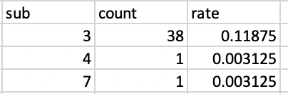
Confusion1: ‘no response’
‘no response detected’ in the response window
memoryTest

Slide 3
Confusion2: index
Candidates: A’ , d’, hit rate, false alarm rate
Sherman et al(2020): A’, hit rate, false alarm rate.
A’: above 0.5
Hit rate: works best
False alarm rate: no findings
Previous analysis: accuracy level
(Hit(counts)+correct_rejection(counts))/total trials
Include ‘no response’ in denominator
Strict measurement ( with confidence rating)

Slide 4
Confusion 3: confidence rating
Strict mode
Loose mode
old
old
Sure old
Unsure old
Unsure new
Sure new
Sure old
Unsure old
Unsure new
Sure new
hit
miss
hit
miss
miss
new
new
Sure old
Unsure old
Unsure new
Sure new
Sure old
Unsure old
Unsure new
Sure new
False alarm
Correct rejection
False alarm
Correct rej
False alarm

Slide 5
This analysis
exclude ‘no response’
Loose mode
A’, d’
hit rate, false alarm rate (‘no response’ included)
Hit_num/old_num
False_alarm_num/new_num
Accuracy level

Slide 6
Memory test: Performance above chance?
Barely
cue_aprime filler_aprime target_aprime
0.5493222 0.5775942 0.5966490
Sherman et al (2020) : 0.68-0.75
cue_dprime filler_dprime target_dprime
0.1384310 0.2363603 0.2832863

Slide 7
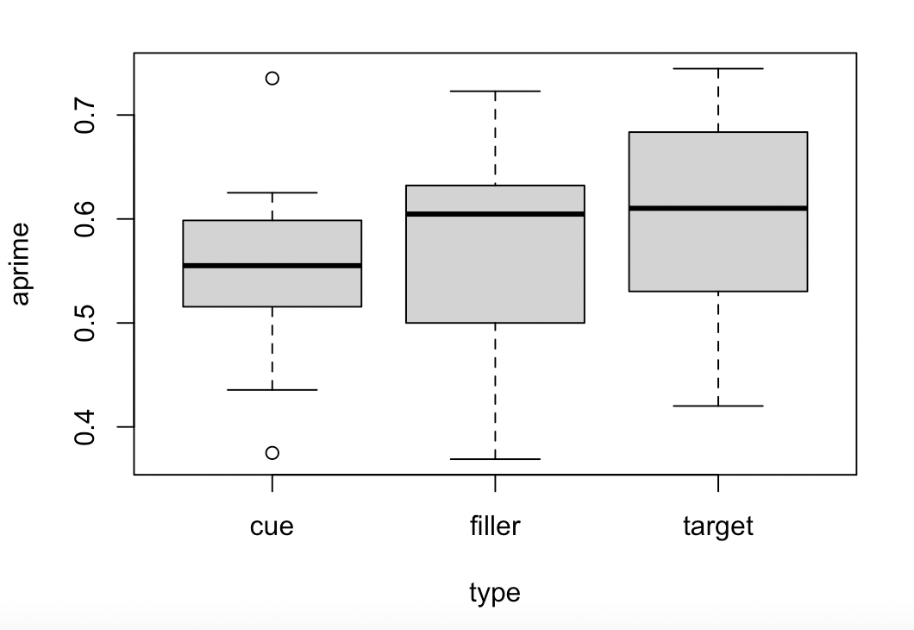
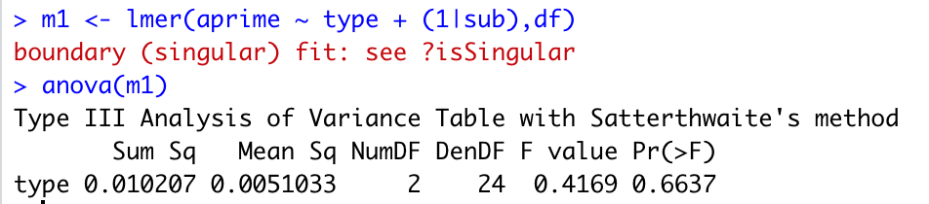
Memory modulated by type?
1 within-subject factor TYPE : 3 level (cue, filler, target)

Slide 8
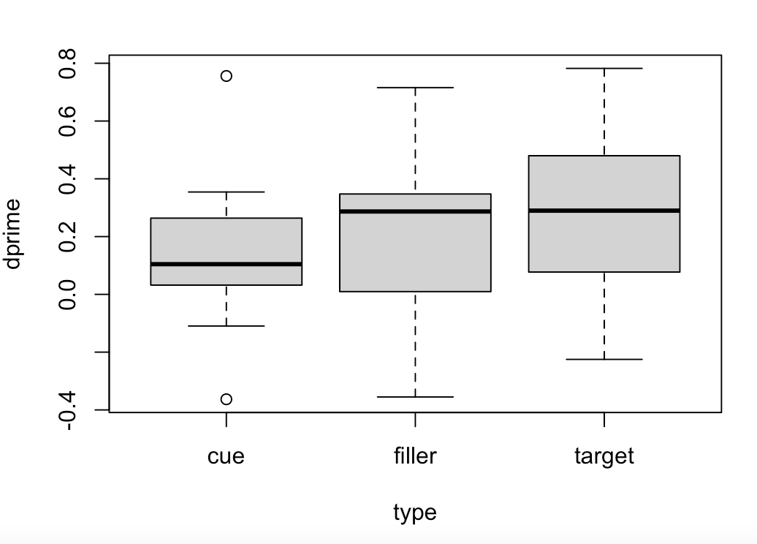
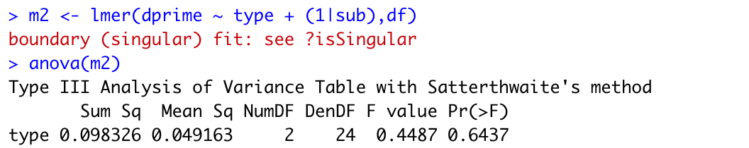
Memory modulated by type?
1 within-subject factor TYPE : 3 level (cue, filler, target)

Slide 9
